Slide 1


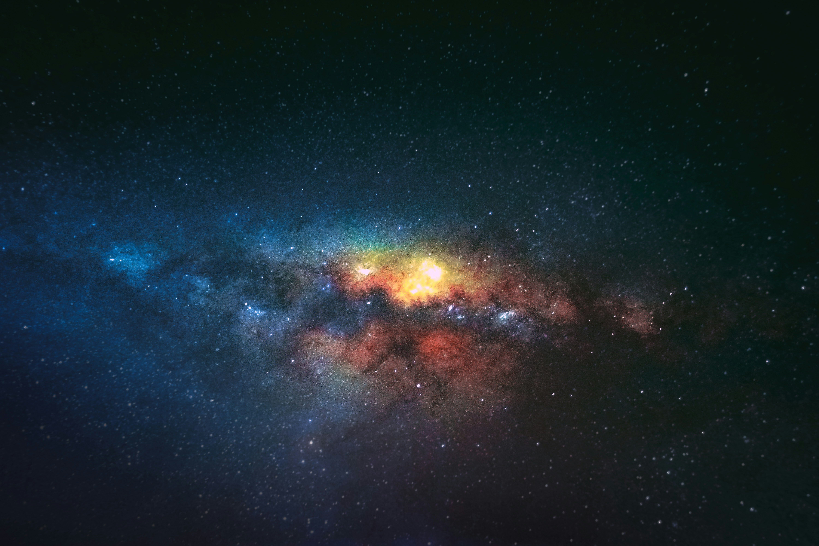
COSMIC JOURNEY
TRAVEL THE SPACE
PrePARED BY: PATEL SHRUTI DILIPBHAI
Batch: D2
Branch: CS&IT
Enrollment no:23002171410043
Roll no: 75

Slide 2
introduction
Welcome to our presentation on Cosmic Journey, a cutting-edge platform dedicated to exploring the wonders of the universe.
Our website serves as a gateway to the latest space discoveries, missions, and celestial phenomena, offering an immersive experience for space enthusiasts, students, and researchers alike.
In this presentation, we will walk you through the key features of our website, its user-friendly design, and how it provides real-time data, educational resources, and interactive experiences to bring space closer to everyone.

Slide 3
KEY FEATURES
Home Page
Overview of the Website
Interactive & engaging design
Mission
Moon Mission
Mars Mission
Mission Exploration
Planets
Planets Information
Visit and Explore

Slide 4
KEY FEATURES
Phepenmoma
Nebula, Blackholes
Information About Galaxy
Quiz
Questions about the Planets and Nebula
Form Submition

Slide 5
Design & Technology Used
Design
Parallax scrolling
Responsive UI
Modern typography
Technology
HTML
CSS (Bootstrap)
JavaScript
Multimedia
Planets
Nebula
Missions
Astronouts Profile

Slide 6
Merits & Demerits
Merits
Anyone around the world can explore space-related content from anywhere.
Provides valuable insights on space missions, astronomy, and futuristic space travel.
Encourages curiosity and innovation in space science.
Demerits
Requires regular updates to keep content relevant and accurate.
Limited Offline Access

Slide 7
Future scope
Providing real-time booking systems for space travel.
AI-powered chatbots for answering space-related queries.
Live streaming of space launches and celestial events
Virtual space station tours & interactive simulations.

Slide 8
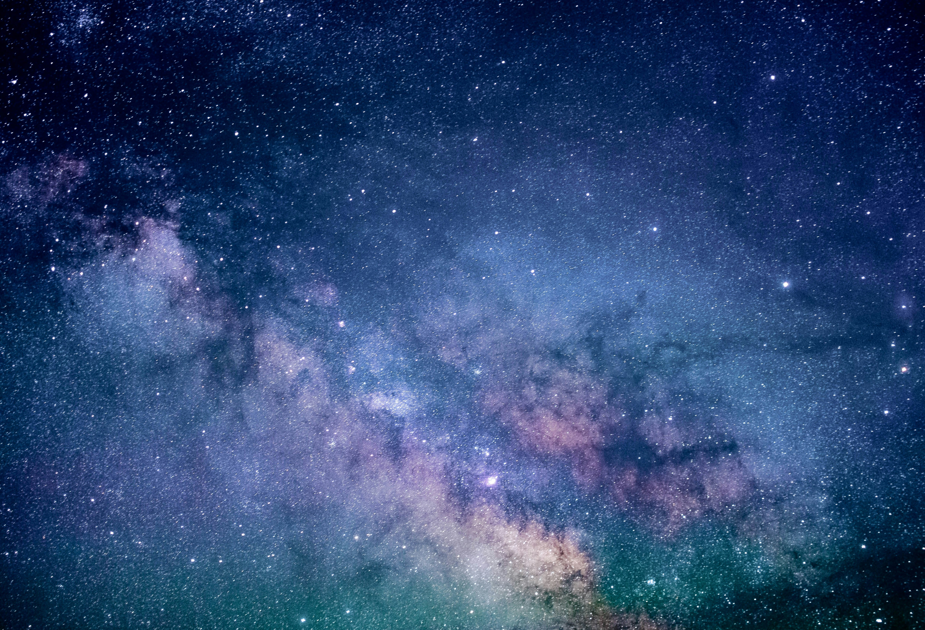
THANK YOU
THANK YOU

